Slide 1
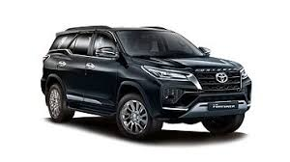
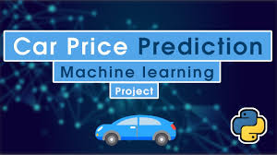
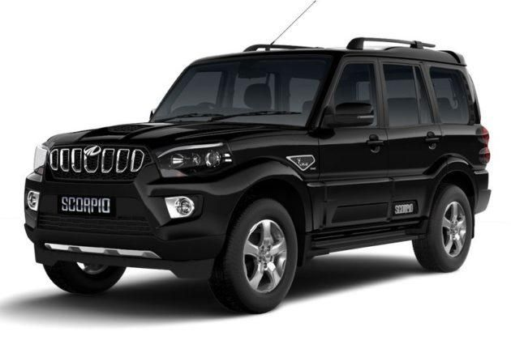
Project Title :
Car Price Prediction
Team Member And Roll No :
Arshaan Singh -- 2210990168
Arshdeep Singh --2210990171
Dapinder Singh –2210990248
Harkirat Singh -- 2210990993

Slide 2
INDEX
Objective
Introduction
Methodology, Approach & Techniques
Algorithm
Flow Chart
Result
Source Code (screenshots)
Conclusion
Reference

Slide 3
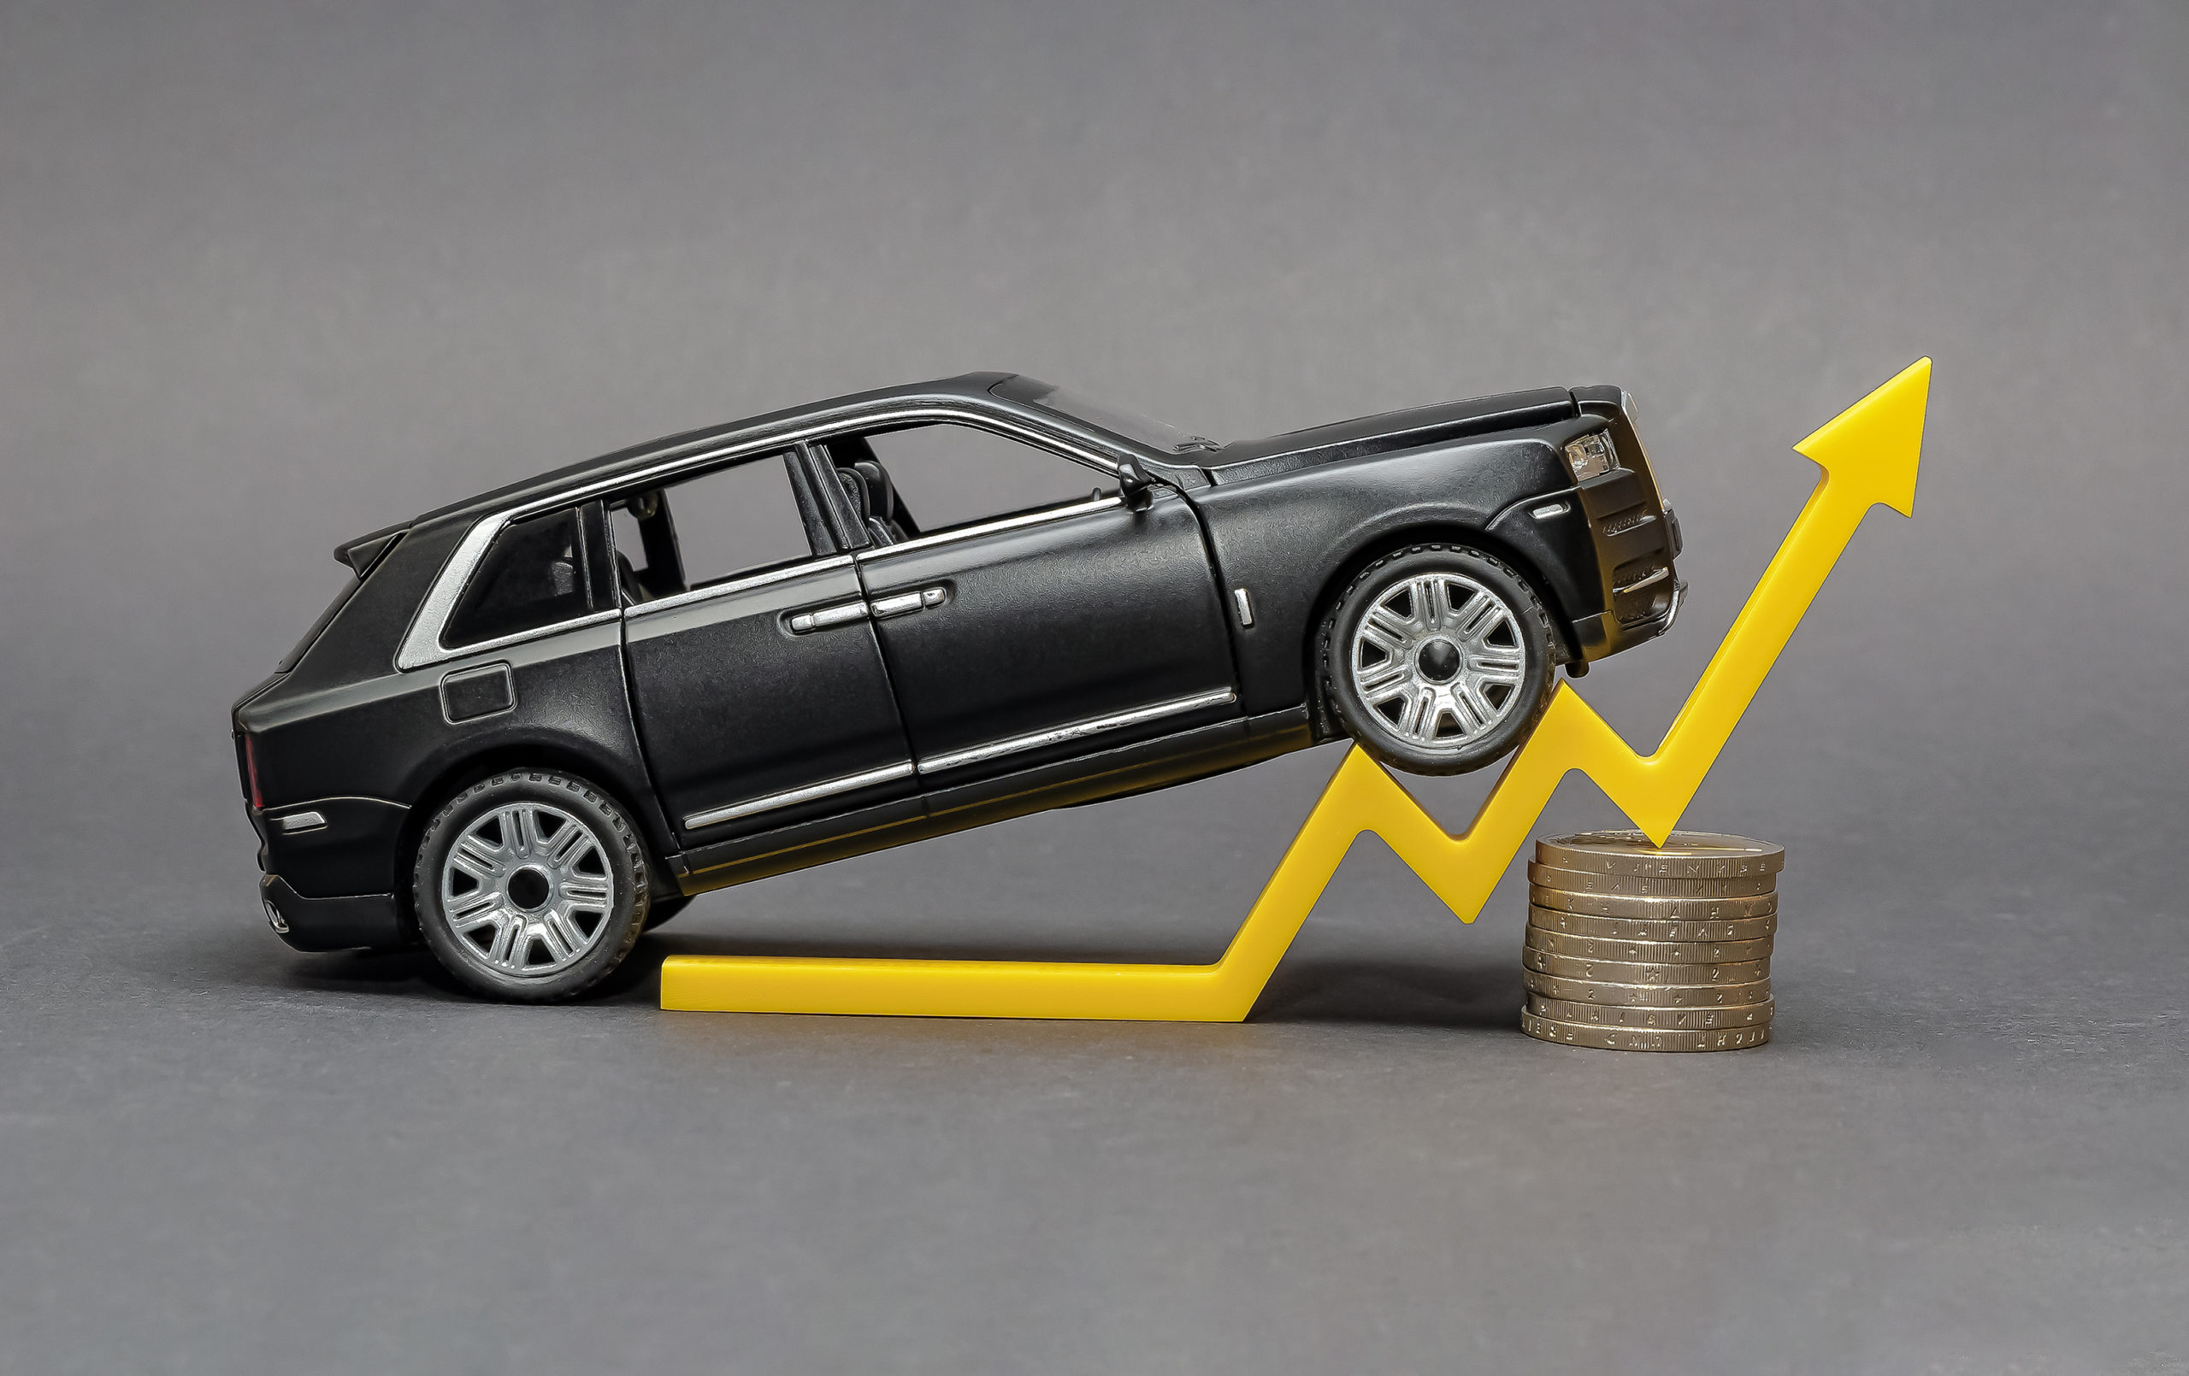
OBJECTIVE
. To develop a Python program using machine learning for car price prediction, we can follow a structured approach involving data collection, data preprocessing, model selection, training, and evaluation.
To develop a machine learning model that predicts the price of a car based on its features.
To preprocess the dataset to ensure the model's accuracy and reliability.
To evaluate the model's performance using appropriate metrics.

Slide 4
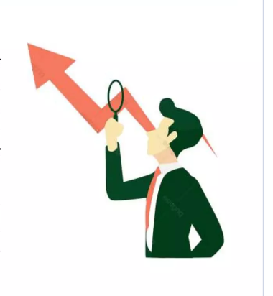
INTRODUCTION
In this particular presentation we will be looking on:
. Relevance: Accurate car price predictions are essential in today's automotive industry to facilitate fair transactions and informed decision-making for both buyers and sellers.
Benefits:
For Buyers: Helps in evaluating if the car's price is fair and within market value.
For Sellers: Assists in setting competitive prices that attract buyers while ensuring profitability.
For Dealerships: Enhances inventory management and pricing strategies.
. Data Utilization: Leverage historical data on car sales, including specifications and pricing, to train the machine learning model
.Outcome: Provide an automated, reliable system for car price prediction that simplifies the decision-making process in the automotive market.

Slide 5
METHODOLOGY
Data Preprocessing:
Cleaning and Preparation: Handle missing values, remove outliers, and normalize numerical features.
Feature Engineering: Select relevant features and encode categorical variables using techniques like One-Hot Encoding.
2. Model Development and Training
Model Selection: Choose appropriate machine learning algorithms such as Random Forest Regressor, Gradient Boosting Machines, or Support Vector Regression.
Training and Tuning: Split the dataset into training and testing sets, train the model, and perform hyperparameter tuning to optimize performance.

Slide 6

APPROACH AND TECHNIQUES
3. Model Development
Algorithm Selection:
Linear Regression: Start with a basic linear model for baseline performance.
Ensemble Methods: Use models like Random Forest Regressor and Gradient Boosting Machines for improved accuracy.
Support Vector Regression (SVR): Consider SVR for complex relationships in high-dimensional spaces.
. Model Training:
Split the data into training and testing sets (e.g., 80/20 split).
Train the models on the training data.

Slide 7
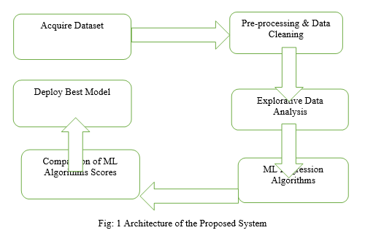
ALGORITHM
When predicting car prices using machine learning, several algorithms can be employed based on their ability to handle different types of data and capture complex relationships. Below are some of the commonly used algorithms:
1. Linear Regression
2. Decision Tree Regressor
3. Random Forest Regressor
4. Gradient Boosting Machines (GBM)
5. Support Vector Regression (SVR)
6. Neural Networks

Slide 8
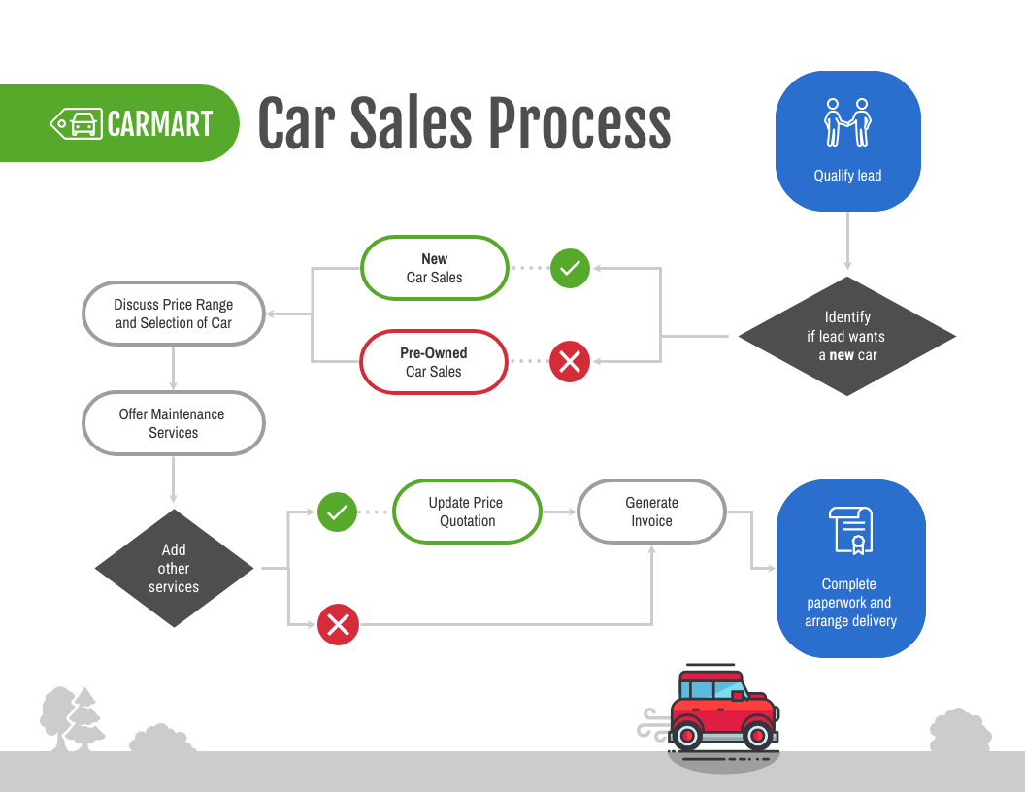
FLOWCHART

Slide 9
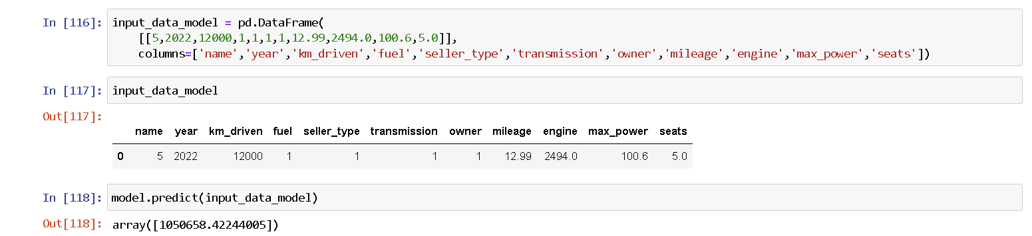
RESULT

Slide 10
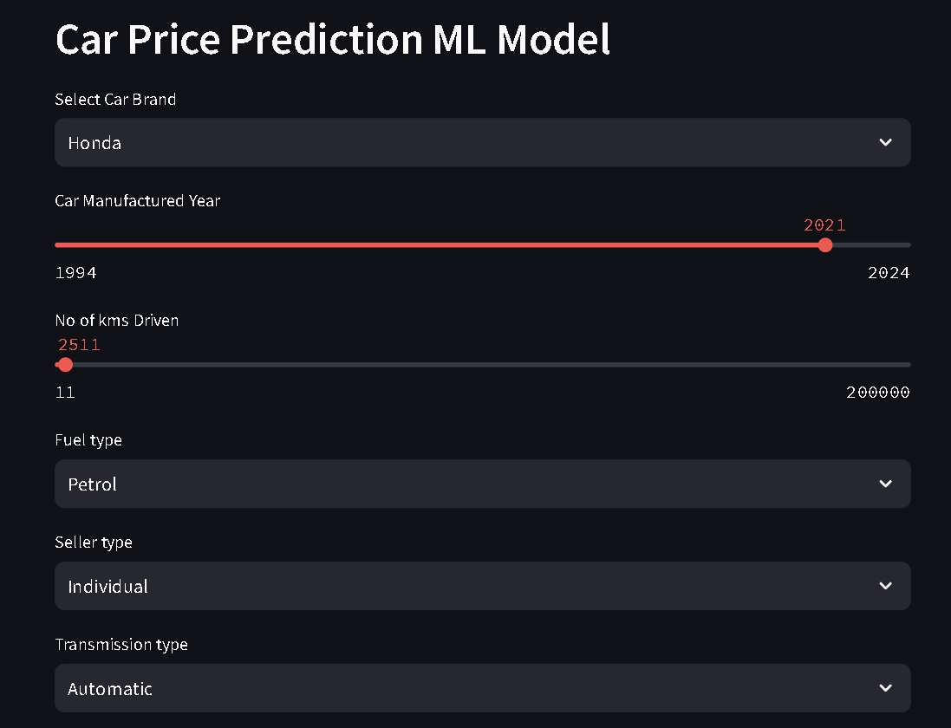
RESULT

Slide 11
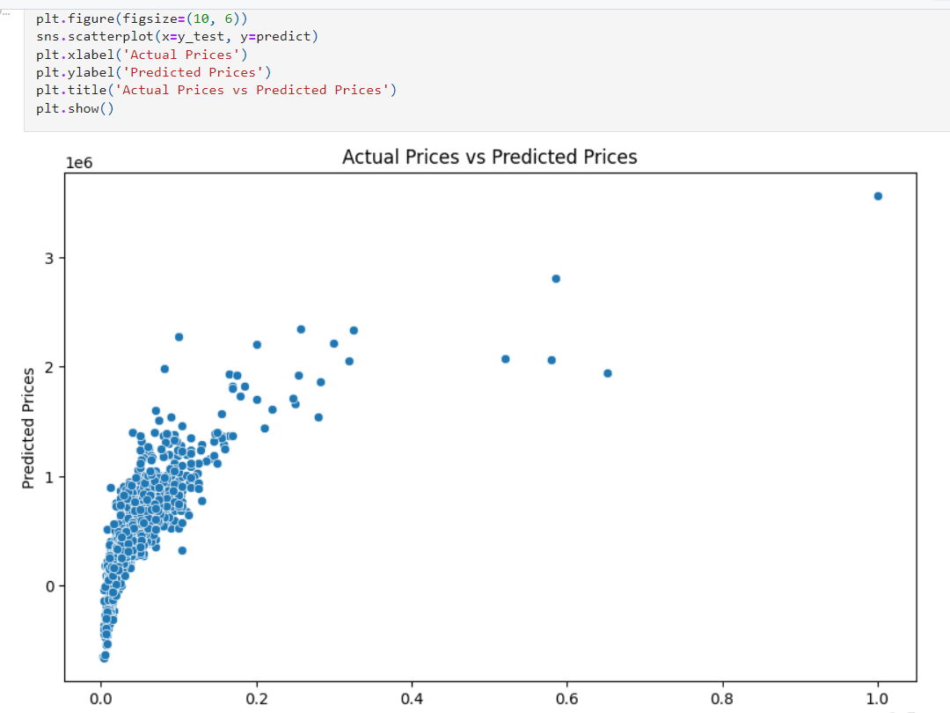
RESULT

Slide 12
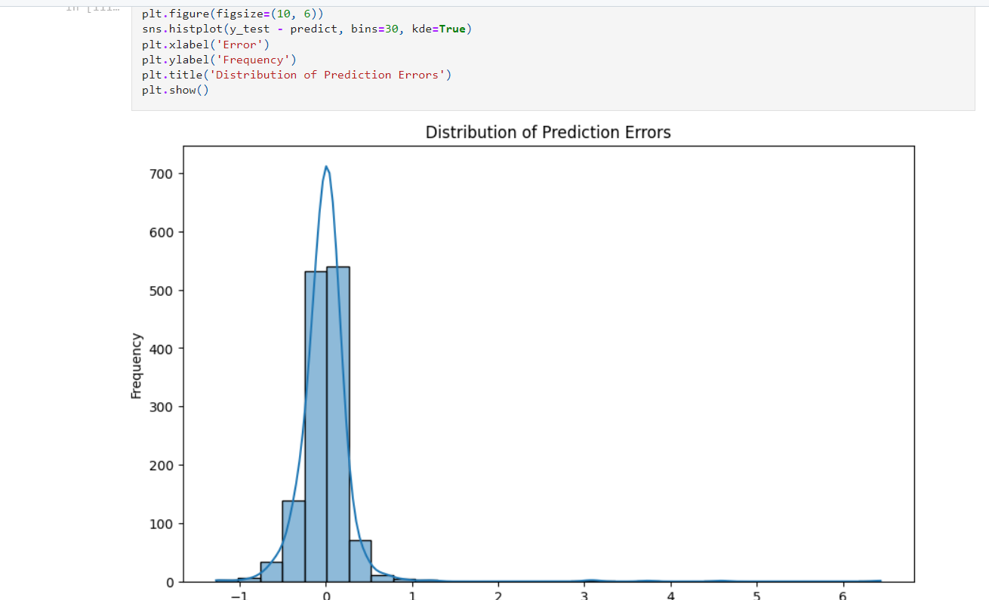
RESULT

Slide 13
CONCLUSION
This research aimed to accurately predict car prices, which depend on several factors such as make, model, year, mileage, engine size, fuel type, transmission, and location.
Car prices can be predicted using different regression algorithms such as Linear Regression, Decision Tree Regression, Random Forest Regression.
Through comprehensive evaluation, the Random Forest Regression algorithm has emerged as the optimal algorithm for car price prediction due to its ability to handle complex, non-linear relationships and its
robustness against overfitting.

Slide 14
REFERENCE
https://thecleverprogrammer.com/2021/08/04/car-price-prediction-with-machine-learning/
https://medium.com/analytics-vidhya/car-price-prediction-end-to-end-machine-learning-web-application-8e9e1fcbd8b3

Slide 15
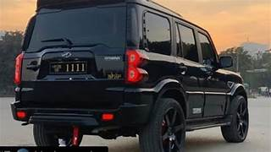
.
THANK YOU!

